Slide 1
Teleportation with Embezzling Catalysts
Junjing Xing
Harbin Engineering University, China
Collaborated with Y. Li, D. Qu, L. Xiao, Z. Fan, H. Ma, P. Xue, K. Bharti, D. E. Koh and Y. Xiao
Commun. Phys. 7, 357 (2024)
Quantum Resource 2025
March 19, 2025 | Jeju

Slide 2
/01
Background

Slide 3
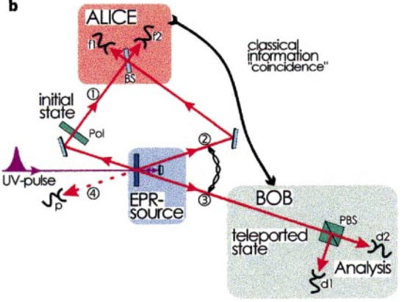
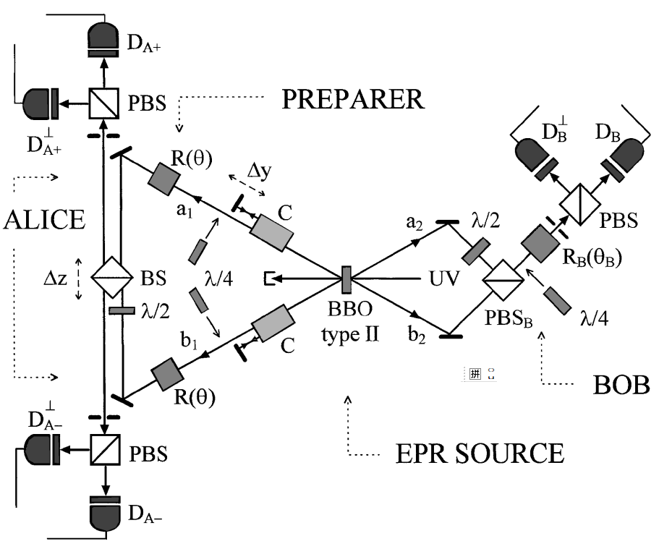
Background —— quantum teleportation
Teleportation Protocol
Nature 390, 575 (1997)
$$Θ_{0}$$
Alice
$$ψ$$
$$φ_{AB}^{+}$$
Bob
Phys. Rev. Lett. 80, 1121 (1998)
Phys. Rev. Lett. 70, 1895 (1993)
The standard teleportation protocol is divided into three parts:
A message state $ψ$
A maximally entangled state $φ_{AB}^{+}$
A local operation and classical communication (LOCC) protocol $Θ_{0}$

Slide 4
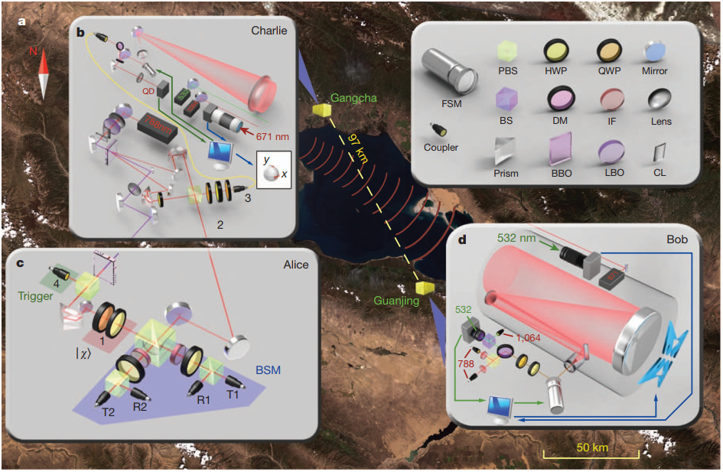
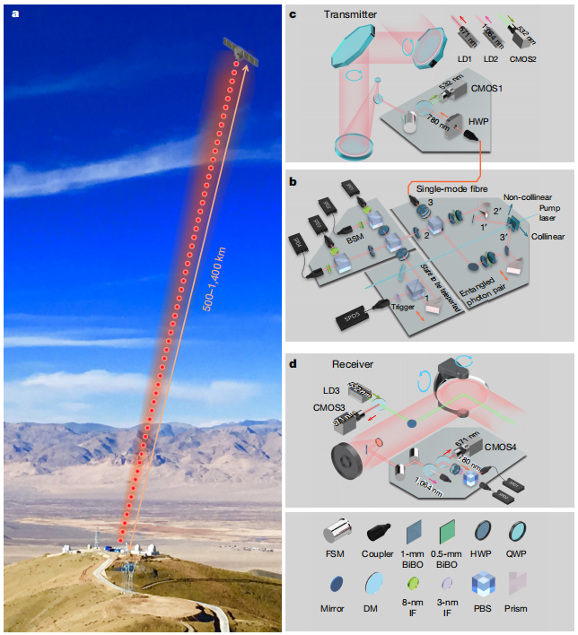
Background —— quantum teleportation
Teleportation Protocol
Nature 488, 185–188 (2012)
$$Θ_{0}$$
100
kilometres
Alice
$$ψ$$
distance
$$φ_{AB}^{+}$$
Bob
Phys. Rev. Lett. 70, 1895 (1993)
1400
kilometres
The standard teleportation protocol is divided into three parts:
A message state $ψ$
A maximally entangled state $φ_{AB}^{+}$
A local operation and classical communication (LOCC) protocol $Θ_{0}$
Nature 549, 70 (2017)

Slide 5
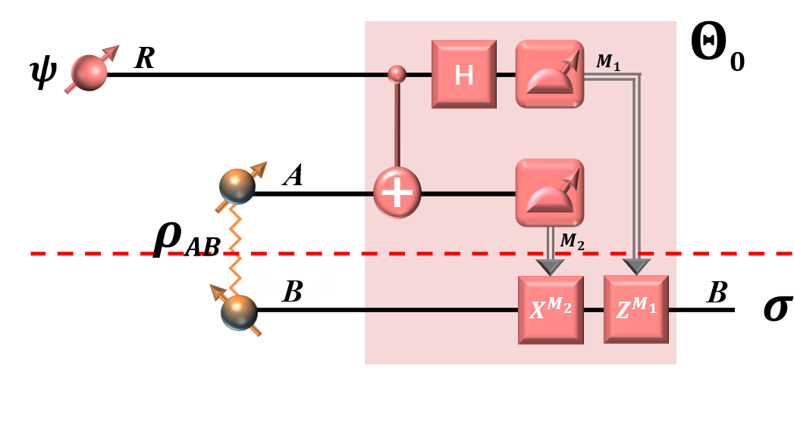
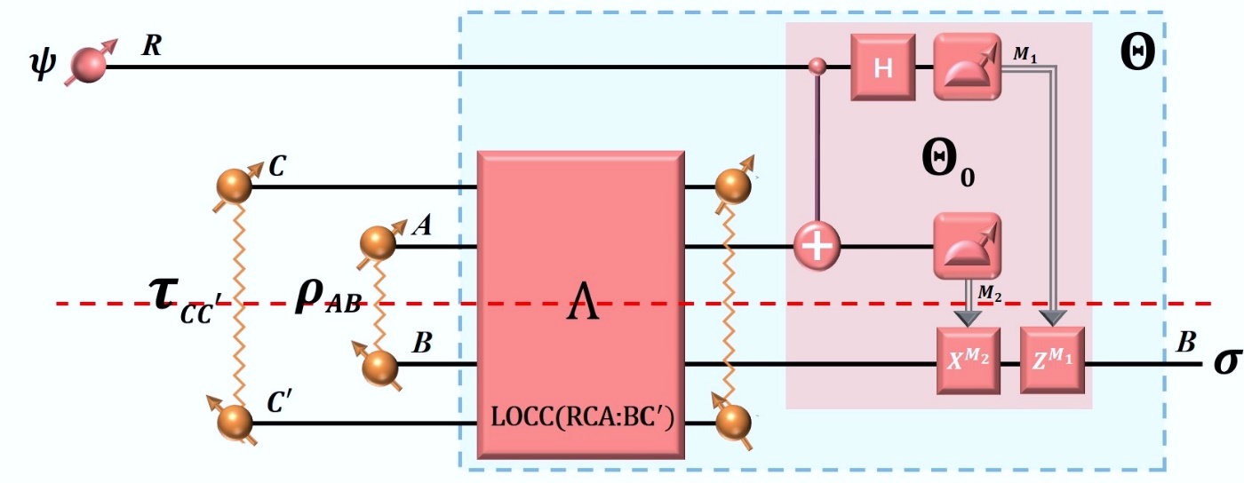
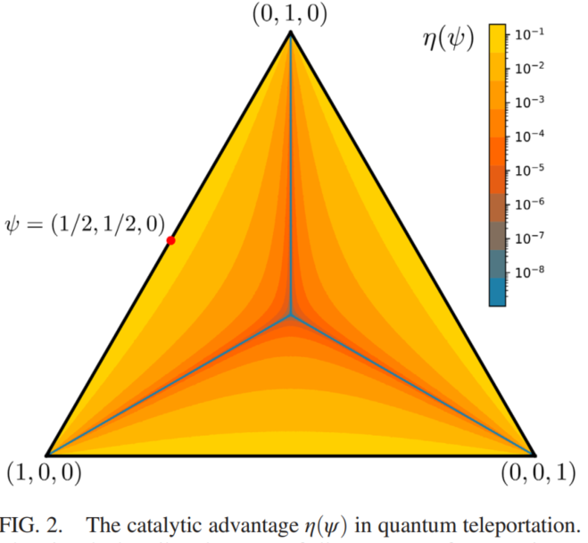
Background —— quantum teleportation
Challenge— Noises
Solution— Catalysts
Noise Teleportation
Catalytic Teleportation
Average fidelity:
Correlated catalyst:
Phys. Rev. A 60, 1888(1999)
Phys. Rev. Lett. 127, 080502(2021)

Slide 6
Background —— quantum teleportation
Question: What would happen if we allow the catalytic system to
undergo small changes during teleportation?

Slide 7
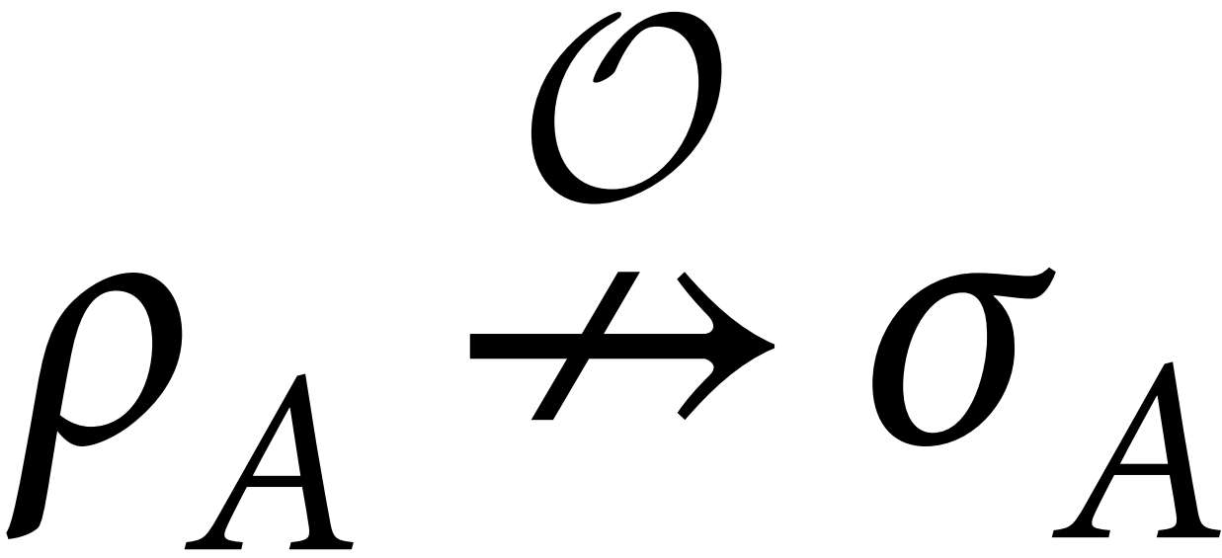
Background —— quantum catalysts
Definition
Exact catalyst $τ_{C}$：
Approximate catalyst $τ_{C}$：
Constraints | Exact catalyst | Approximate catalyst
 |  | Correlated catalyst （$δ=$ 0） | Embezzling catalyst （$δ>$ 0）
Error on the finial state | × | √ | √
Correlation between the finial state and the catalyst | × | √ | √
Error on the returned catalyst | × | × | √
Rep. Prog. Phys. 86, 116002 (2023)
Rev. Mod. Phys. 96, 025005 (2024)

Slide 8
Background —— quantum catalysts
Applications of approximate catalysts
Quantum task | Correlated catalyst | Embezzling catalyst
 |  | Convex-split lemma | Embezzling states family
Entanglement distillation | [4] | [7] | [1]
Coherence distillation | [5] | [2] | [2]
Quantum teleportation | [3] | [7] | [7]
Quantum communication | [6] | [8] | [8]
Superdense coding | ? | × | [8]
[1] Phys. Rev. A 67,060302 (2003)
[4] Phys. Rev. Lett. 127, 150503 (2021)
[7] Commun. Phys. 7, 357 (2024)
[2] Phys. Rev. A 100,042323 (2019)
[5] Phys. Rev. A 107, 012404 (2023)
[8] arXiv:2406.14395(2024)
[3] Phys. Rev. Lett. 127, 080502 (2021)
[6] Quantum 8, 1290 (2024)

Slide 9
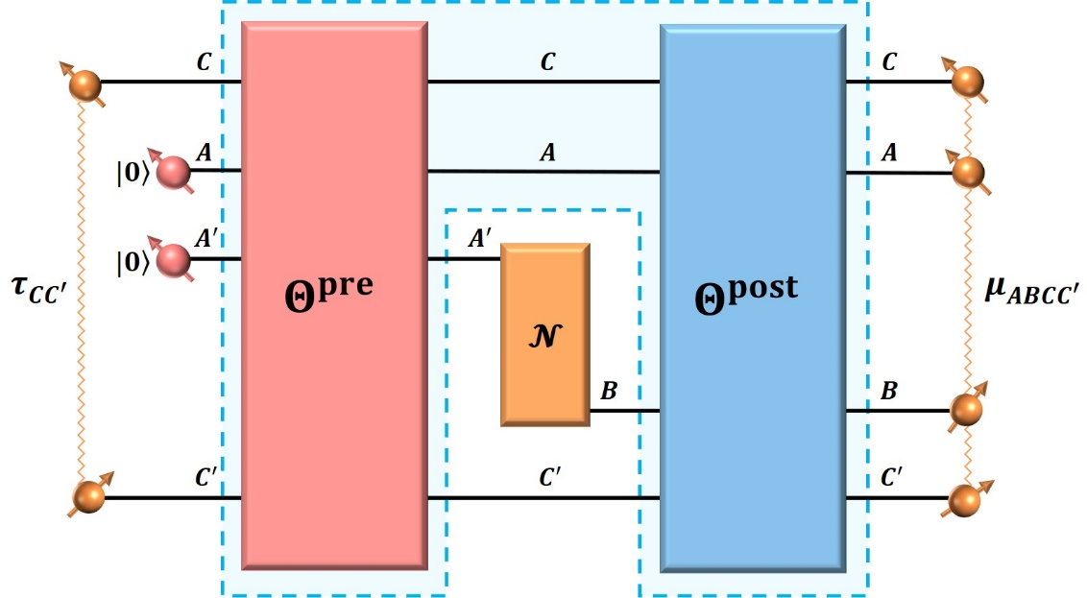
Accompanying work
Improving the capacity of quantum channels

Slide 10
/02
Main Results

Slide 11
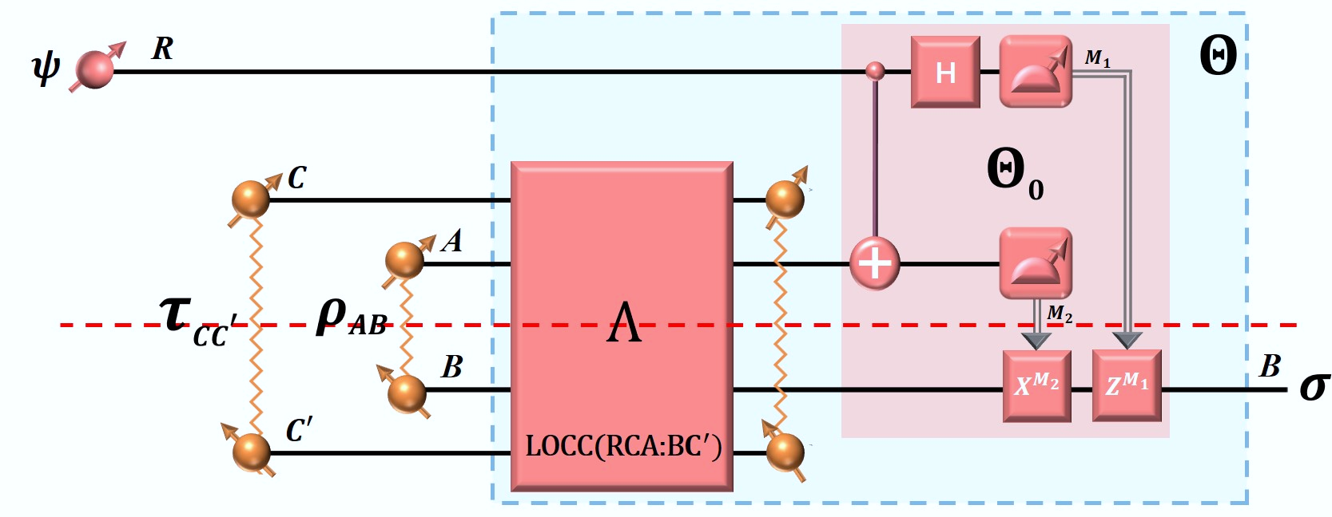
Teleportation with embezzling catalysts
The consumption of embezzling catalysts:
Alice
Average Fidelity $f_{c}(ρ_{AB})$:
Bob
Main Theorem:
Given any initial shared state $ρ_{AB}$ and any positive numbers $ϵ>0$ and $δ>0$, we can find a finite dimensional embezzling catalyst $τ_{CC^{′}}$ and a LOCC operation $Θ∈$LOCC(${RAC:BC}^{′}$) such that
and

Slide 12
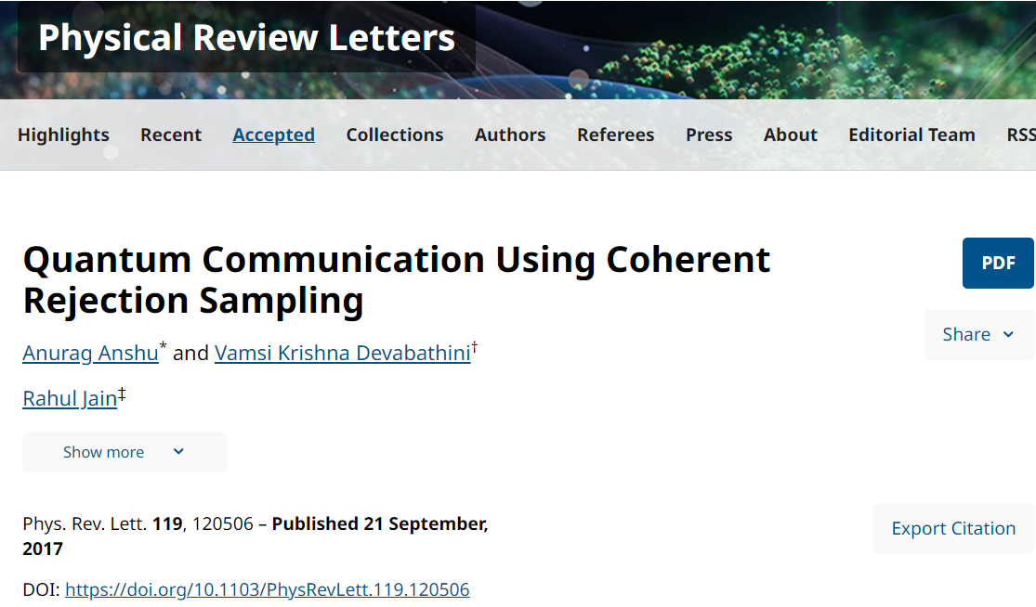
Teleportation with embezzling catalysts
Convex-split-lemma-assisted teleportation
Construction of catalyst:
Given any bipartite state $ρ_{AB}$ and any positive numbers
$ϵ>0$ and $δ>0$, we choose that
$ζ$.
Constraints
Results
Note: $d≔\dim{A}=\dim{B}$,$k≔D_{max}(ρ||τ)$

Slide 13
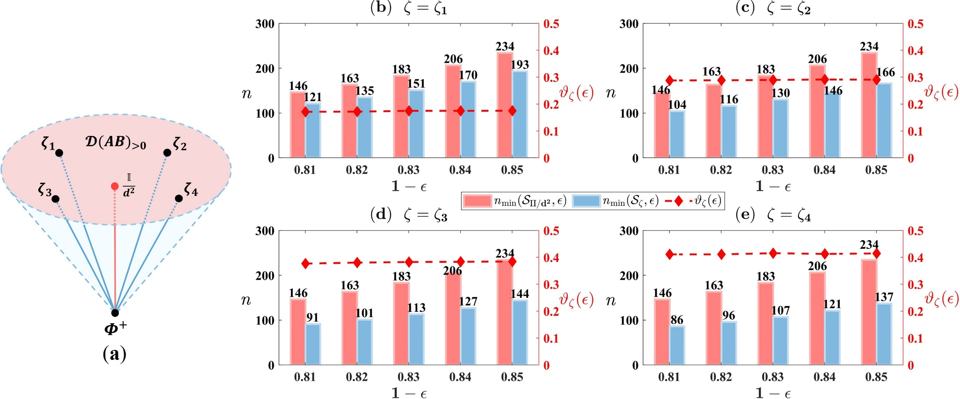
Teleportation with embezzling catalysts
Convex-split-lemma-assisted teleportation
Dimensionality reduction:
$$τ=pφ^{+}+\left(1−p\right)ζ$$

Slide 14
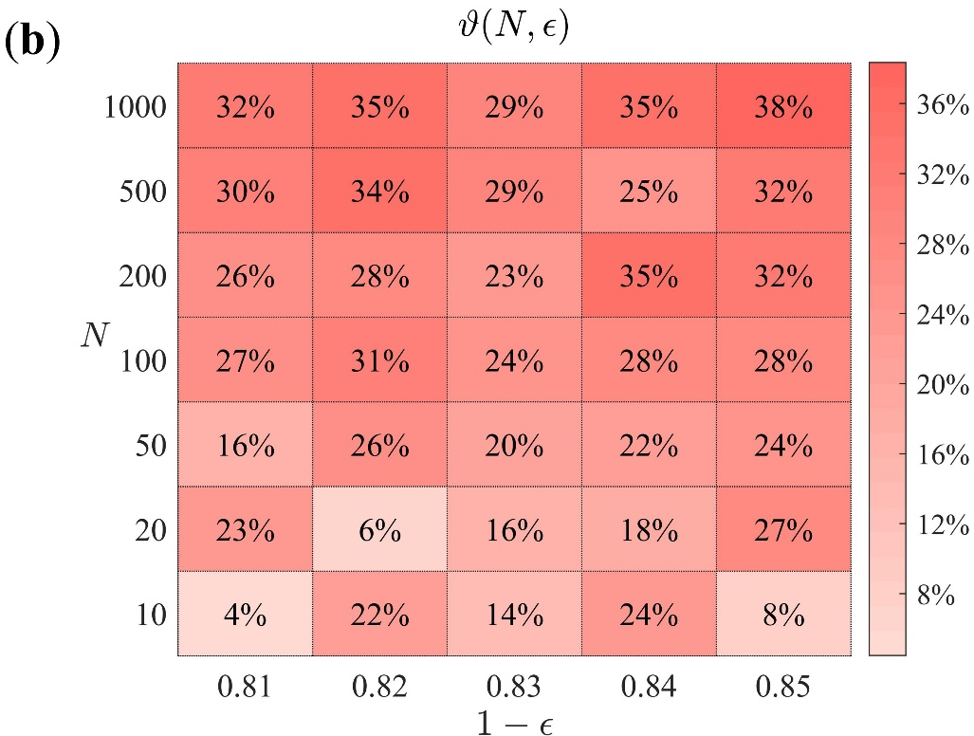
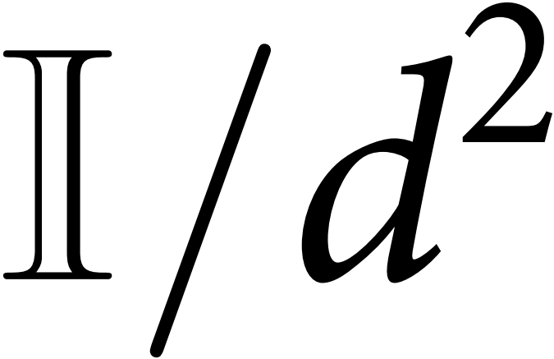
Teleportation with embezzling catalysts
Convex-split-lemma-assisted teleportation
Dimensionality reduction:
$$τ=pφ^{+}+\left(1−p\right)ζ$$
: randomly select N full-ranked states $ζ$
: fix $ζ$ to be the maximally mixed state

Slide 15
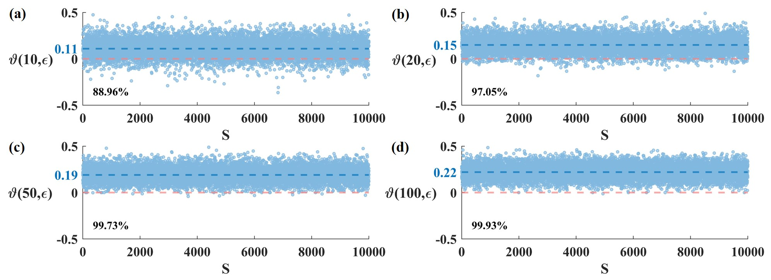
Teleportation with embezzling catalysts
Convex-split-lemma-assisted teleportation
Dimensionality reduction:
Monte Carlo simulations
Our method of reducing the dimension of embezzling catalysts by randomly choosing full-ranked states is statistically robust and unbiased with respect to the initial state shared between the sender and receiver.

Slide 16
Teleportation with embezzling catalysts
Embezzling-state-assisted teleportation
Construction of catalyst:
Given any bipartite state $ρ_{AB}$ and any positive numbers $ϵ>0$ and $δ>0$, we choose the embezzling state
to be the embezzling catalyst.
If the Schmidt rank M of $τ^{E}$satisfies
Constraints
we have
and
Results

Slide 17
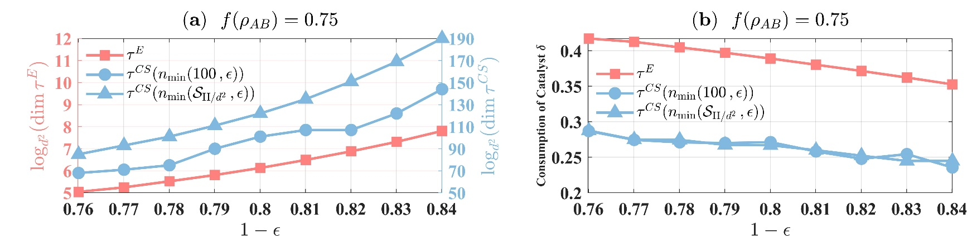
Teleportation with embezzling catalysts
Embezzling-state-assisted teleportation
Comparisons across different embezzling catalysts:
For the dimension required for catalytic systems, the embezzling-state-assisted protocol outperforms the convex-split-lemma-assisted protocol.
For the consumption of catalysts, the convex-split-lemma-assisted protocol is better than the embezzling-state-assisted protocol.

Slide 18
/03
Comparisons
with correlated catalysts
Phys. Rev. Lett. 127, 080502(2021)

Slide 19
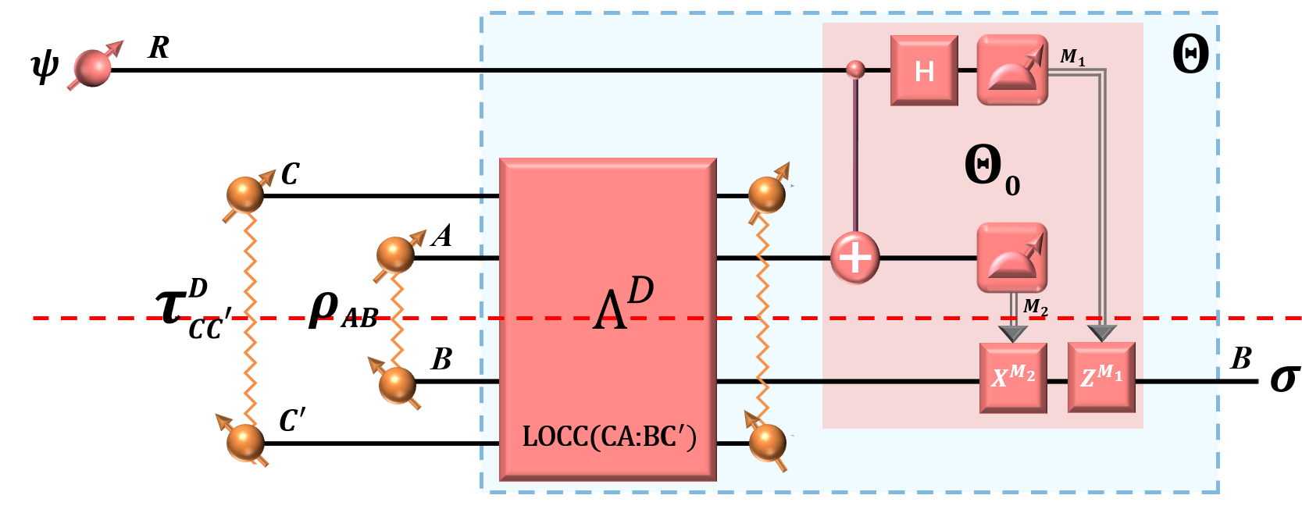
Comparision with correlated catalysts
Teleportation with correlated catalysts
Alice
Bob
The construction of correlated catalysts:
The LOCC operation $Λ^{D}$ :
(Duan state)
The consumption of correlated catalysts:
Phys. Rev. Lett. 127, 080502(2021)

Slide 20
Comparision with correlated catalysts
Teleportation with correlated catalysts
Alice
Bob
Average Fidelity:
Lemma :
For any pure state $φ_{AB}$, we have
a computable lower bound
Phys. Rev. Lett. 127, 080502(2021)

Slide 21
Comparision with correlated catalysts
Comparision between embezzling catalysts and correlated catalysts
Correlated catalyst: Duan state
Approximate catalyst
Embezzling states
Embezzling catalyst:
Convex-split lemma
The performance of catalytic protocols：
Region | $$f>0.9$$
Pink | √ (without the catalyst)
Deep Blue | √ (with the catalyst)
Light Blue | ? (with the catalyst）
Embezzling catalysts can enhance the fidelity beyond 0.9 for all initial states.
Embezzling catalysts offer a more feasible solution.

Slide 22
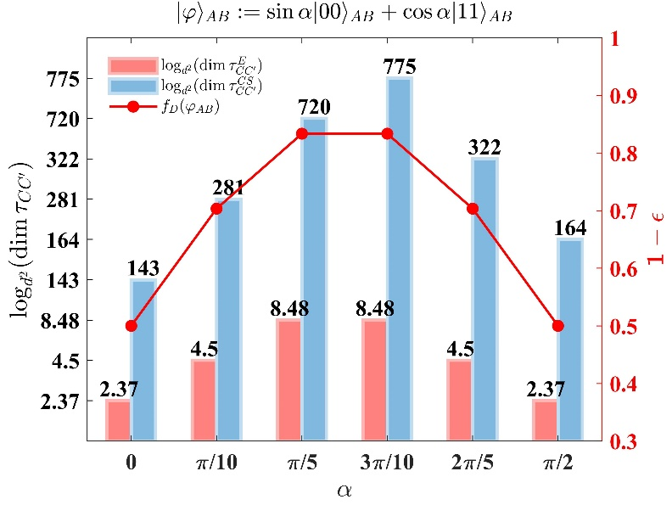
Comparision with correlated catalysts
Comparision between embezzling catalysts and correlated catalysts
Correlated catalyst: Duan state
Approximate catalyst
Embezzling states
Embezzling catalyst:
Convex-split lemma
The Dimension requirements in catalytic protocols：
The finite-dimensional embezzling catalysts can achieve the same performance as infinite-dimensional correlated catalysts.

Slide 23
/04
Conclusion
The constructions of embezzling catalysts;
The dimension reduction of embezzling catalysts;
The trade-off between the dimension and consumption of different embezzling catalysts.

Slide 24
Thank
you
for
your
attention

Slide 25
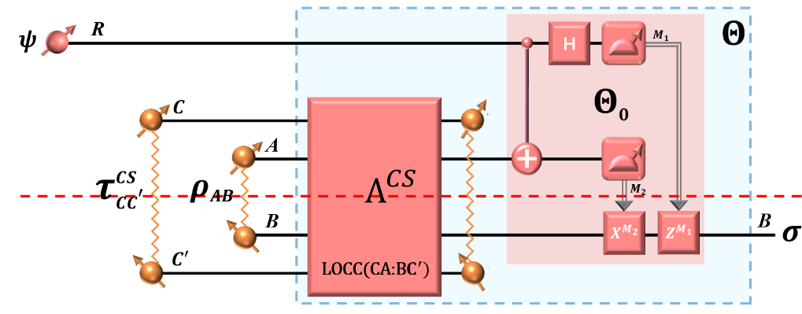
Teleportation with embezzling catalysts
Convex-split-lemma-assisted teleportation
Technology (Convex-split Lemma):
Given quantum states $ρ, τ ∈ 𝒟\left(AB\right)$ with$k:=D_{max}\left(ρ∥τ \right)$, there exists an LOCC operation $Λ^{CS}$ such that
Alice randomly generates an integer t from {1, …, n} with uniform probability 1/n, and communicates this number to Bob;
Alice and Bob perform a SWAP operation between systems $A_{1}B_{1}$ and $A_{t}B_{t}$.
Phys. Rev. Lett. 119, 120506 (2017)

Slide 26
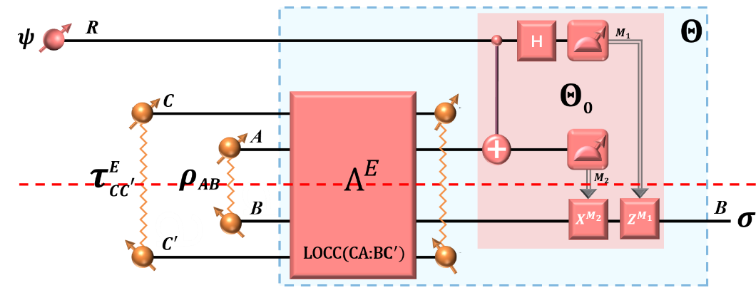
Teleportation with embezzling catalysts
Embezzling-state-assisted teleportation
Technology (Embezzling state):
Let $τ^{E}$ be an embezzling state on systems $CC^{′}$, defined as
.
Then for any bipartite state $ρ$ on systems AB, there always exists an LOCC operation $Λ^{E}$ such that
② $U_{AC}⊗U_{BC^{′}}$
①

